Slide 1
Machine Reading Comprehension using
Deep Learning
Prasanna Kumar Challa
Prathwish Shetty
Sriram Jayaraman

Slide 2
Task
Nikola Tesla (Serbian Cyrillic: Никола Тесла; 10 July 1856 – 7 January 1943) was a Serbian American inventor, electrical engineer, mechanical engineer, physicist, and futurist best known for his contributions to the design of the modern alternating current (AC) electricity supply system.
In what year was Nikola Tesla born?
Ground Truth Answers: 1856 1856 1856
Prediction: 1856
What is Tesla's home country?
Ground Truth Answers: Serbian Serbian Serbian
Prediction: Serbian

Slide 3
Goal
Implement a bidirectional attention flow network to answer questions in the SQuAD dataset
Adopted Bi-directional Attention Flow model developed by Minjoon Seo et. al. (2016)
Machine understanding of the passage and question each of which is represented by a sequence of word tokens.
Extract an arbitrary continuous answer span from the original passage to give the answer

Slide 4
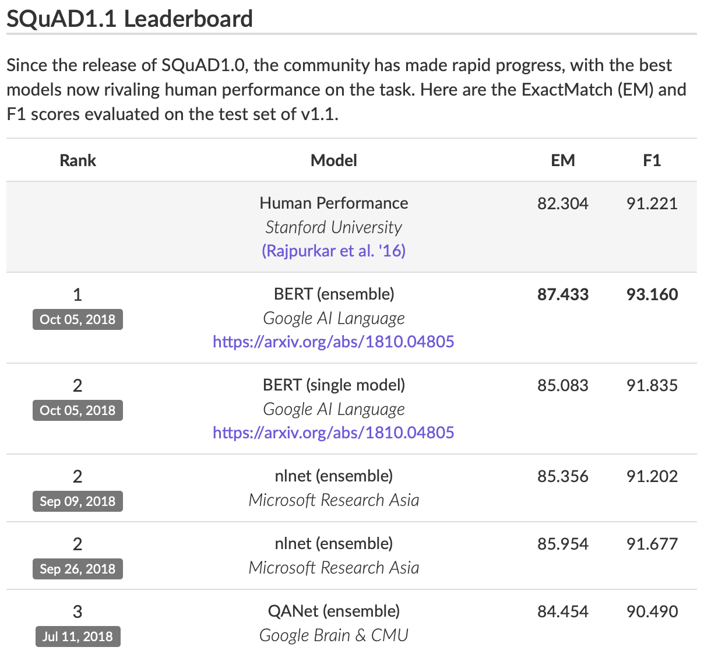
Dataset
Subset of SQuAD dataset v1.1 containing 100 Wikipedia articles is used
Q&A created by humans through crowdsourcing making it realistic
It has 5071 passages and 22618 question answer pairs in total
The size of vocabulary is around 50k
Notes:
What the actual size is and what we have reduced it to?

Slide 5
Related Work
Rajpurkar et.al.: logistic regression model based on detailed linguistic features.(Baseline model developed in 2016)
Xiong et.al.: dynamic coattention network for encoding and attention modeling
Wang et.al.: Multi-perspective context matching,
Our model is based on Minjoon Seo et.al. :
Utilize bidirectional attention flow encoding and attention schemes
Combining question and context influence via a bidirectional LSTM
Multistage encoding decoding

Slide 6
Preprocessing Data
Tokenize paragraph, question and answer by splitting on spaces and separating punctuation from text
Clipped any paragraph longer than 400 words in length, and conversely padded shorter paragraphs with the buffer token
Used pre-trained GloVe vectors (Pennington, et al.) to obtain a word vector for each word in the question and paragraph
For question with multiple answers, have multiple instances of the same question with different answers assigned to each instance.
Notes:
##Optimization done by batches, hence we need to extend paragraphs and questions to have a fixed length. At training time, we chose a paragraph size of 300 and a question size of 30 and discard the rest and at test time the longest paragraph size and question size in the dev/test set. We then fill the vectors with 0 and create a boolean mask stating if the values are added or not.
##This simplifies the architecture for training and can still be used for longer size when testing as the variables never depend on the number of words (recurrent approach). We chose those limits to keep more than 95% of the examples at training time.
##We finally convert words to its corresponding indices in the embedding table(see section6) for an easier lookup and a decrease in variable storage.

Slide 7
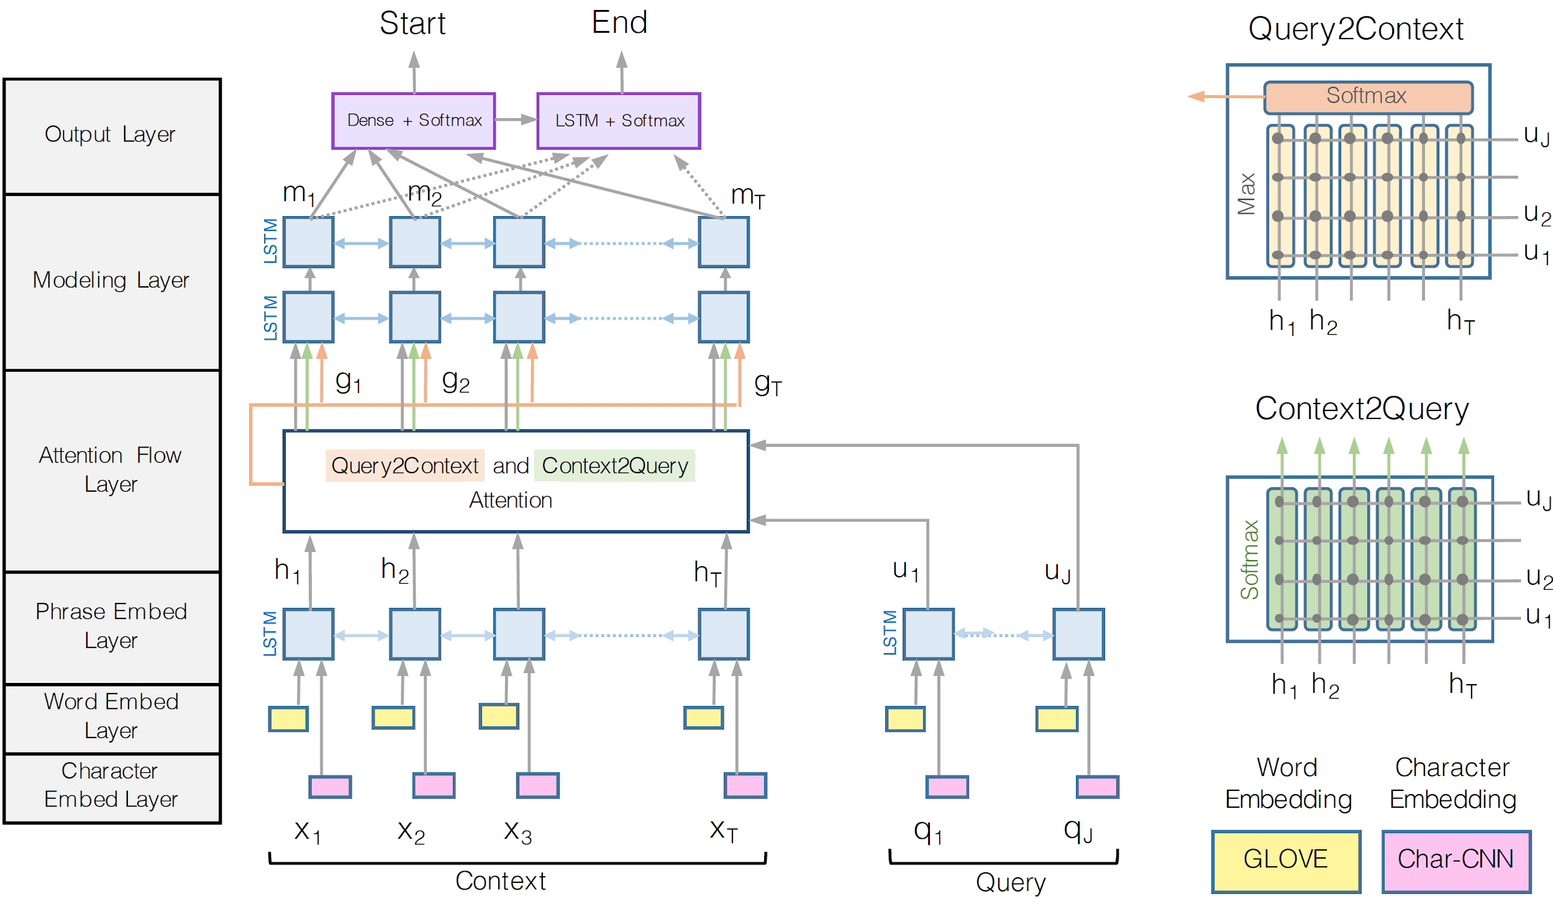
Bi-directional Attention Flow

Slide 8
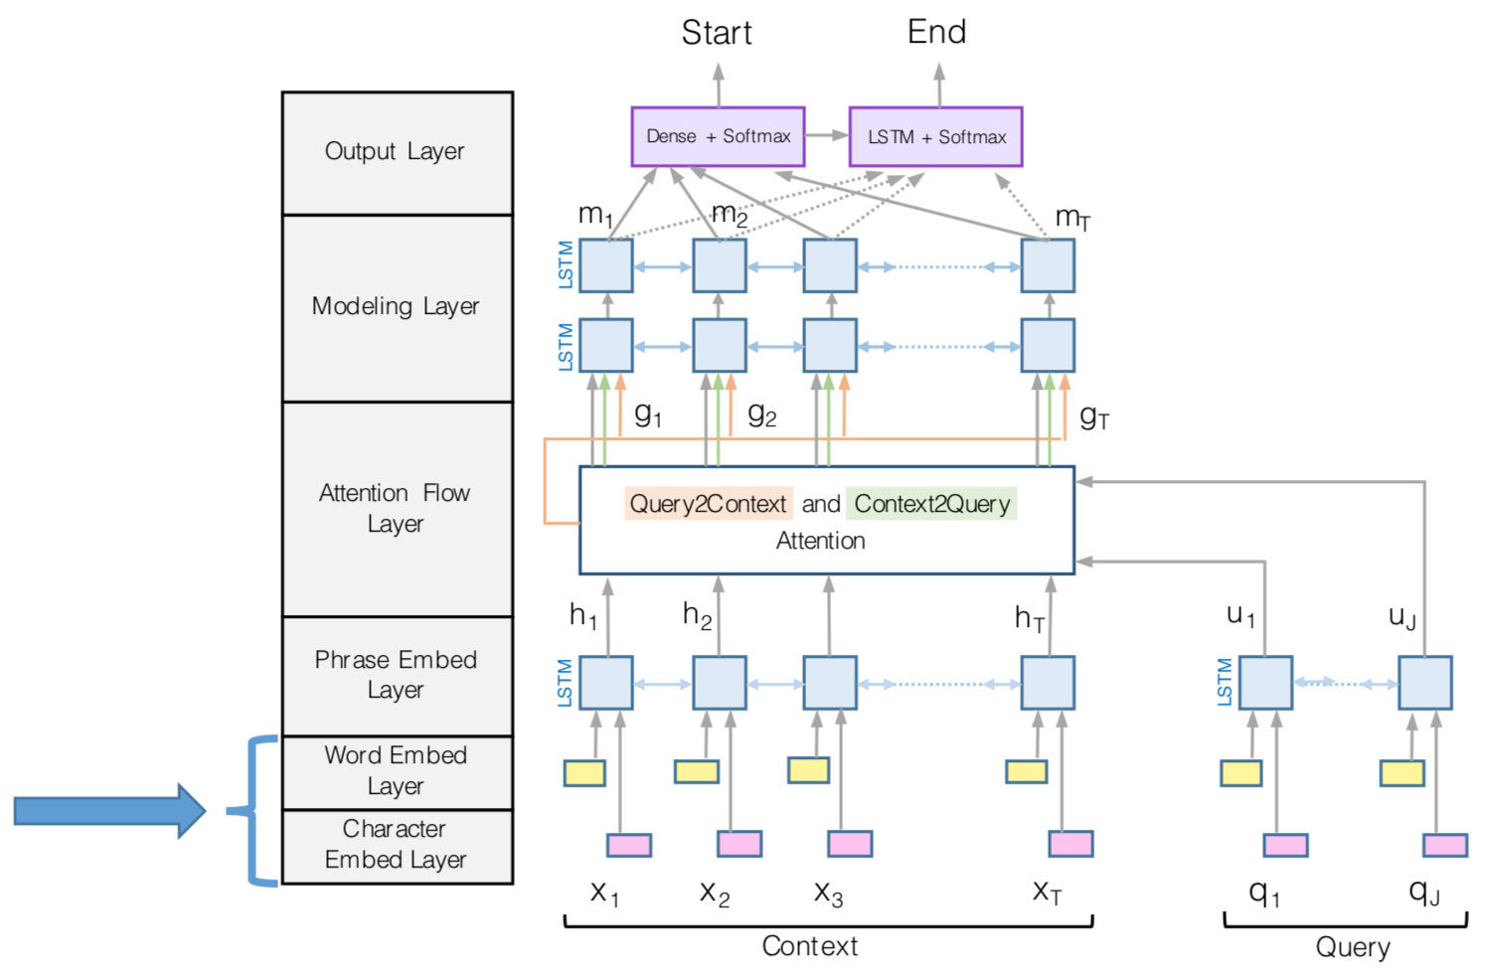
Layer 1: Character and Word Embedding
Character embedding:
Input: list a characters
Output: 1 hot encoded sequence of vectors with 8 dimensionsional vector per every single character
Word Embedding:
We use pre-trained word vectors, GloVe, to obtain the fixed word embedding of each word.
The concatenation of the character and word embedding vectors is passed to two-layer Highway Network

Slide 9
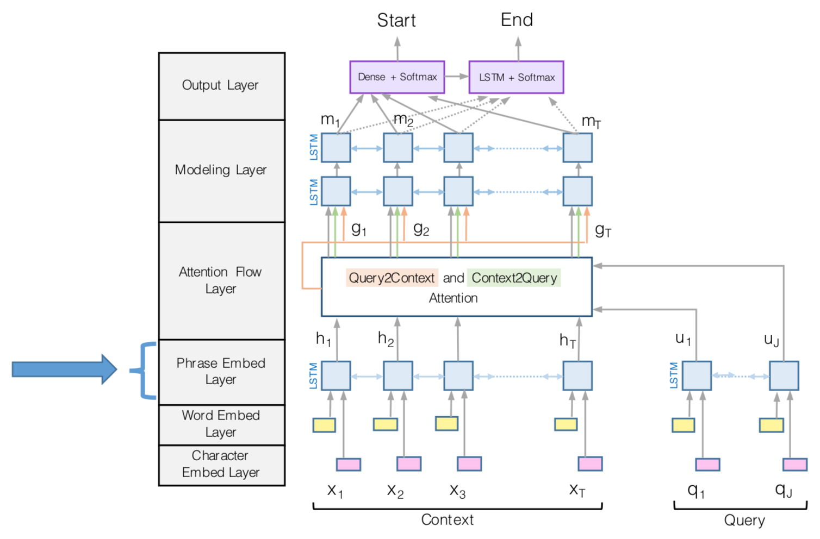
Layer 2: Phase Embedding Layer
Char-word embeddings of query and context
We use a Long Short-Term Memory Network (LSTM) on top of the embeddings provided by the previous layers to model the temporal interactions between words
Apply bidirectional RNN (LSTM) for both query and context
The outputs are word representations aware of their neighbors

Slide 10
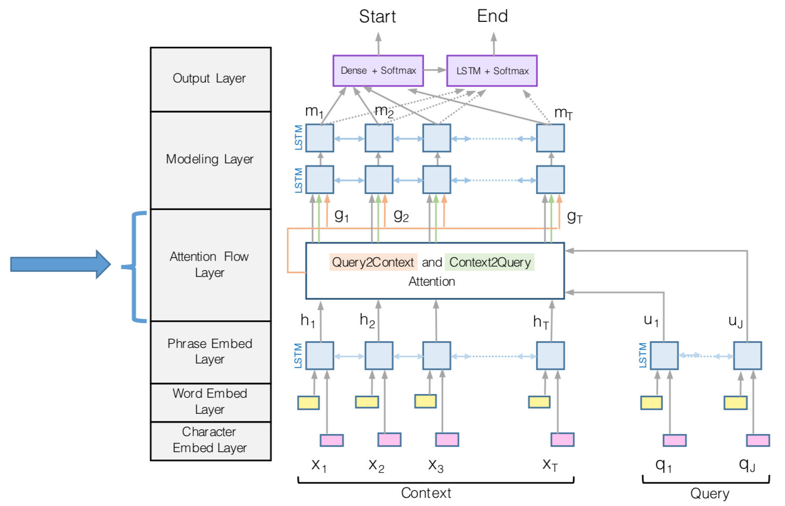
Layer 3: Attention Layer
Input: phrase-aware context and query words
Output: query-aware representations of context words
Context-to-query attention: For each (phrase-aware) context word, choose the most relevant word from the (phrase-aware) query words
Query-to-context attention: Choose the context word that is most relevant to any of query words

Slide 11
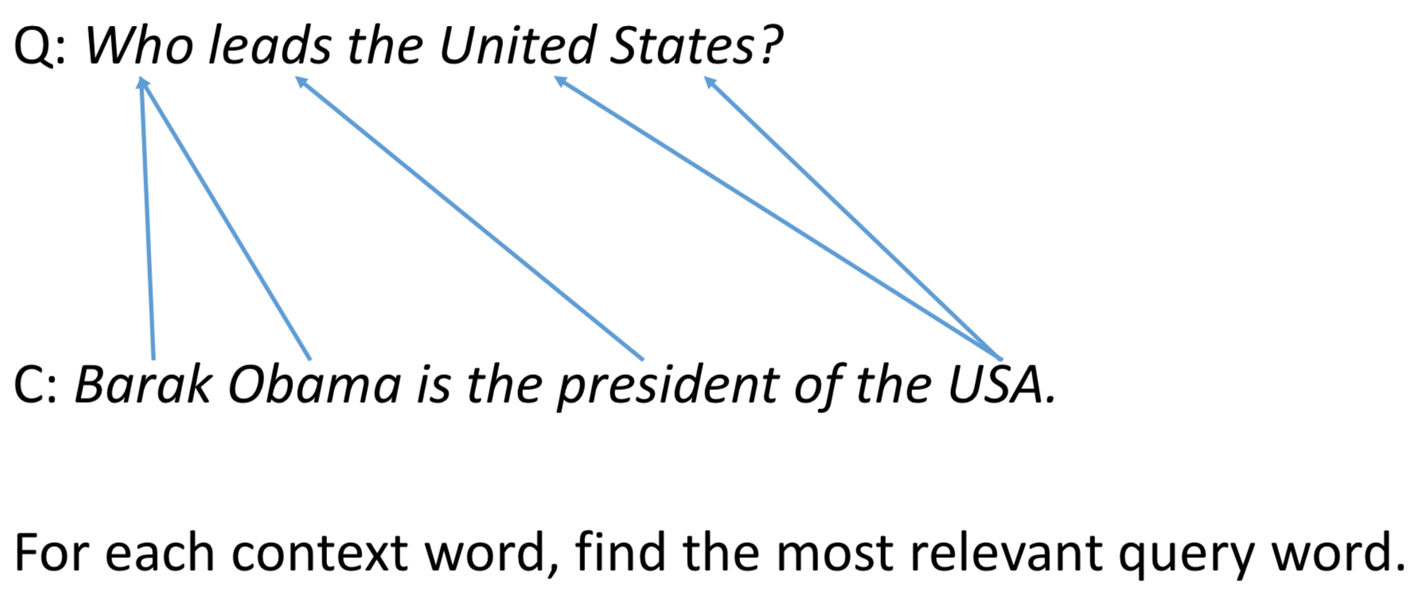
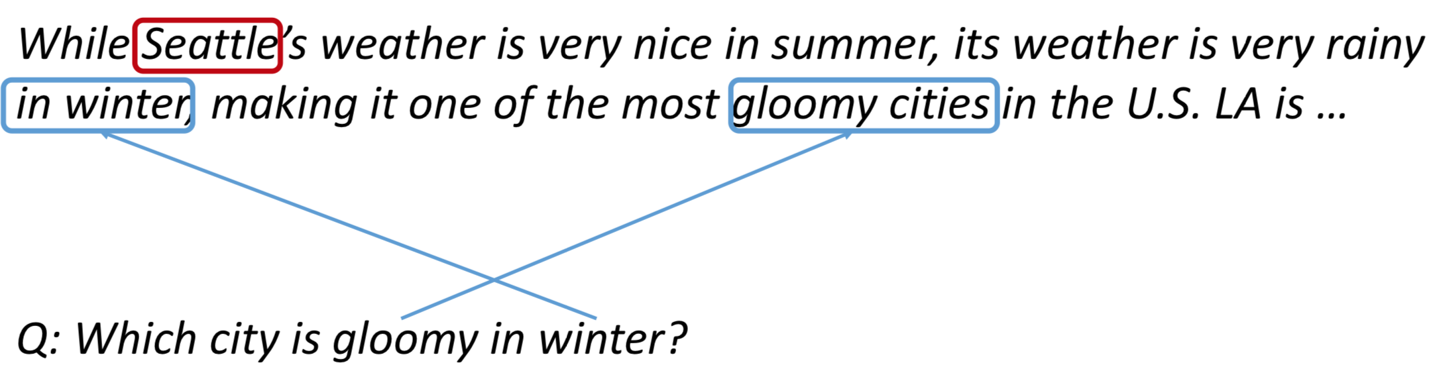
Layer 3: Attention Layer
Context-to-Query Attention (C2Q)
Query-to-Context Attention (Q2C)

Slide 12
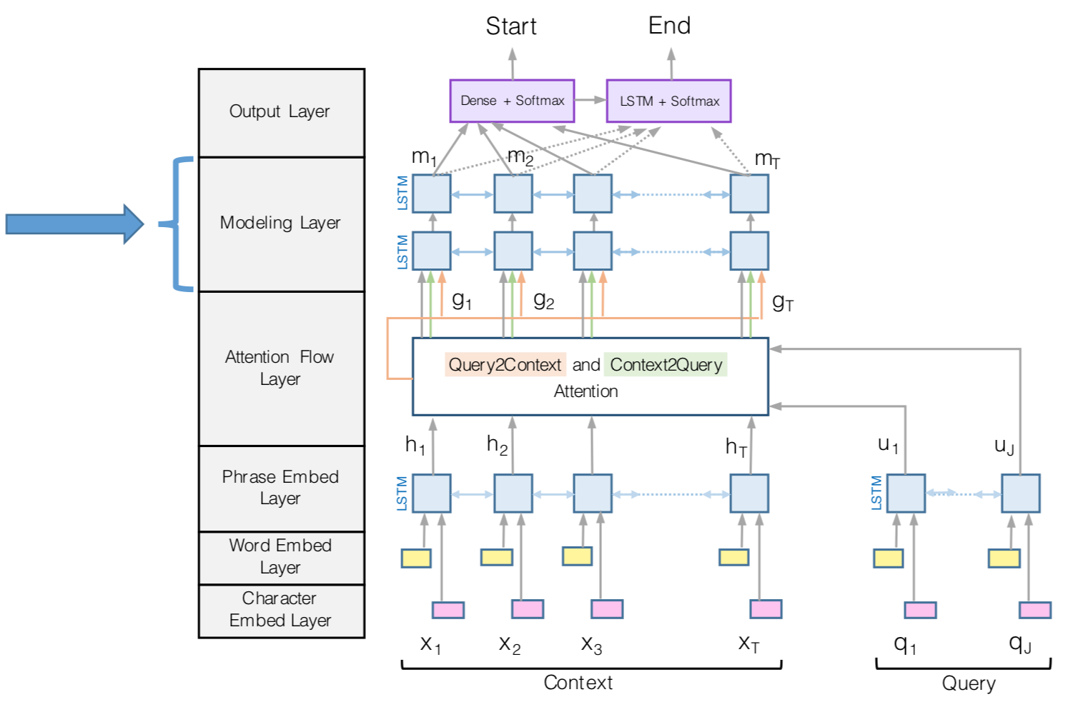
Layer 4: Modeling Layer
Input: query-aware representations of context words
Output: interaction among the context words conditioned on the query
We use two of Bi-Directional LSTM in both forward and backward direction

Slide 13
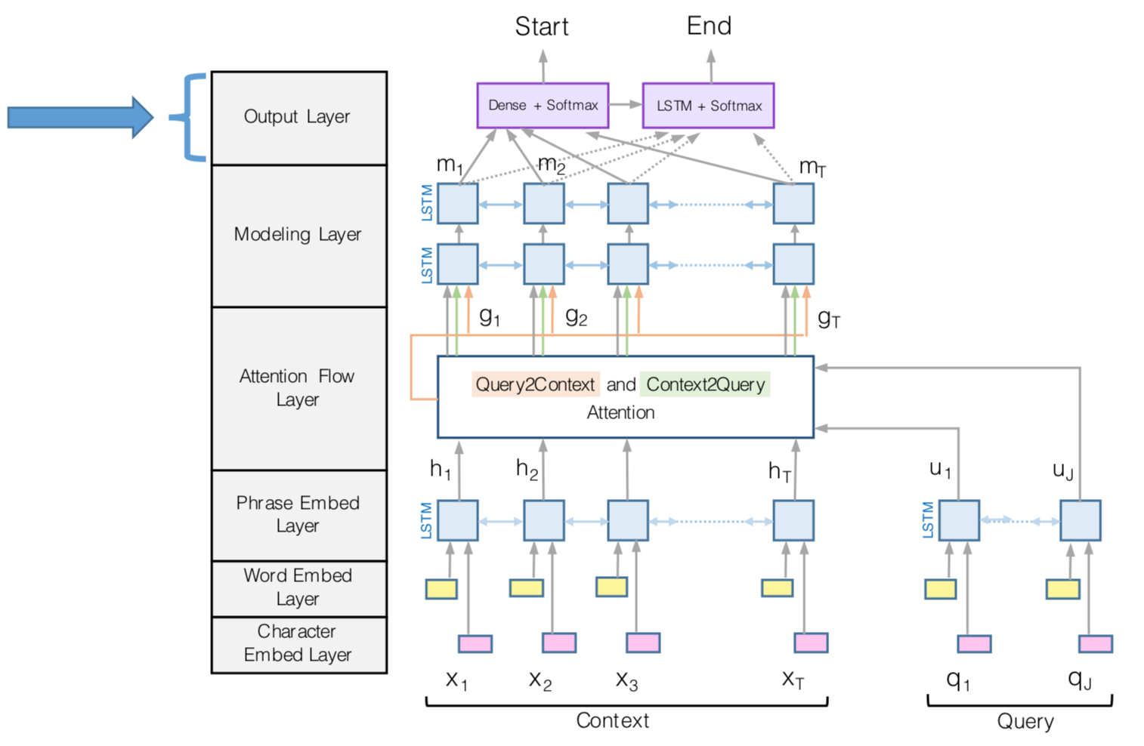
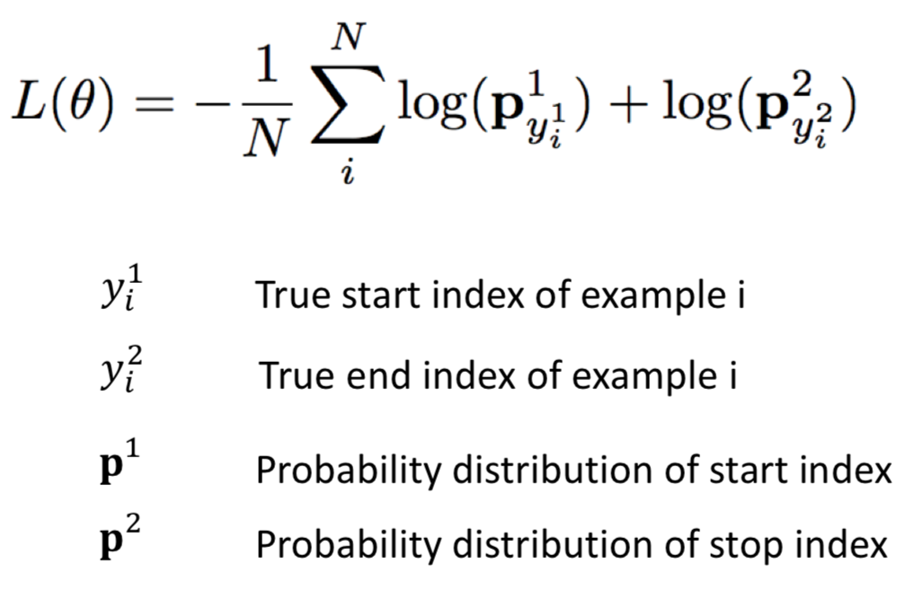
Layer 5: Output Layer
Input: Interaction among the context words conditioned on the query
Output: Probability distribution of the start index and end index over the entire paragraph

Slide 14
Evaluation Metrics
EM Score:
1 if predicted and ground truth answer is exactly same and 0 otherwise
F1 Score:
F1 score is harmonic mean between precision and recall
Precision = Number of Common Tokens / Number of Predicted Tokens
Recall = Number of Common Tokens / Number of Ground Truth Tokens
In case of multiple answers, we take the maximum of the scores

Slide 15
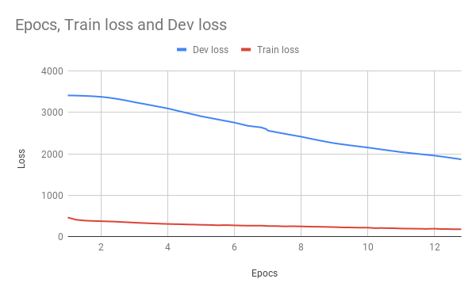
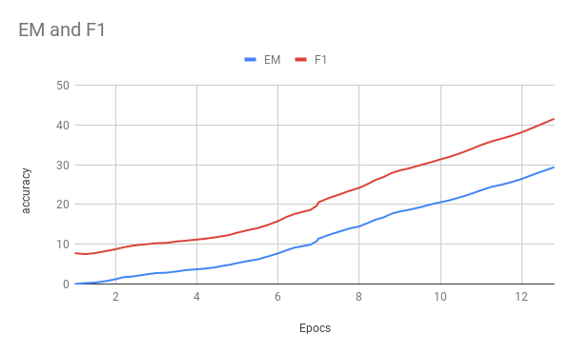
Hyperparameters
Epochs: 12
Learning Rate: 0.3
Layers: 2
Hidden Units: 100
Dropout: 0.2
Optimizer: AdaDelta
Char Embedding: 8d
Glove Embedding: 100d

Slide 16
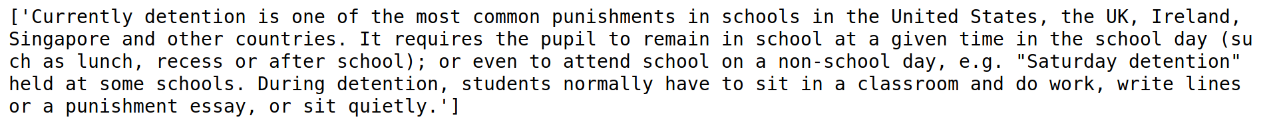


Predictions
Correct Prediction:
Incorrect Prediction:

Slide 17
Results
Human Performance EM: 82.304, F1: 91.221
Best Model Performance EM: 87.433, F1: 93.160
BiDAF Original Model Performance EM: 68.000, F1: 77.300
Our Model Performance EM: 29.423, F1: 41.627

Slide 18
References
[1] Pranav Rajpurkar, Jian Zhang, Konstantin Lopyrev, Percy Liang. “SQuAD: 100,000+ Questions for Machine Comprehension of Text”
[2] Minjoon Seo, Aniruddha Kembhavi, Ali Farhadi, Hannaneh Hajishirzi. “Bidirectional Attention Flow for Machine Comprehension”
[3] Caiming Xiong, Victor Zhong, and Richard Socher. “Dynamic coattention networks for question answering”

